Slide 1
Numpy and Pytorch
CENG 499 Recitation 1

Slide 2
Outline
Numpy
Basic Numpy Operations
Pytorch
Computation Graph
Pytorch Tensor
Auto-grad System/Engine
Optimizers
Loss Functions
Neural Network Training with Pytorch
Adaline Example
Feed Forward Network Example

Slide 3
Numpy
A scientific computing package
Fast array manipulation (with optimized C implementation)
Slicing
Concatenation
Searching
Matrix and vector manipulations
Matrix Multiplication
Transpose
Dot Product
Linear algebra routines
Eigenvalue decomposition
Determinant
Inverse
Integration with Pytorch and Scikitlearn

Slide 4
Numpy Array (ndarray)
numpy.ndarray is the Numpy’s array class, has the following attributes:
ndarray.ndim: dimension of the array
ndarray.shape: size of each dimension as a tuple
ndarray.size: total number of elements in the array
Ndarray.dtype: the type of the elements in the array
Ndarray.itemsize: the size in bytes for each element in the array
Ndarray.ndim.data: the buffer containing the actual array elements

Slide 5
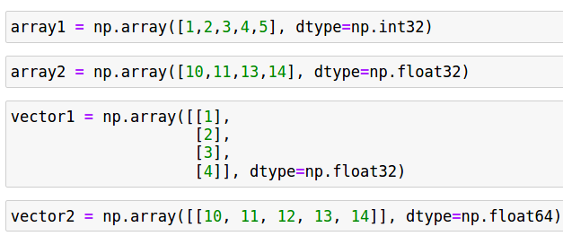


Numpy Array Creation
numpy.array: creates an array from given sequence/list/data

Slide 6
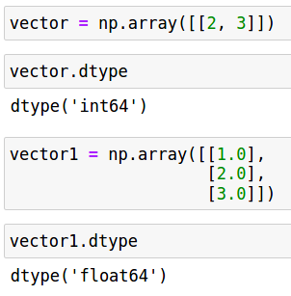
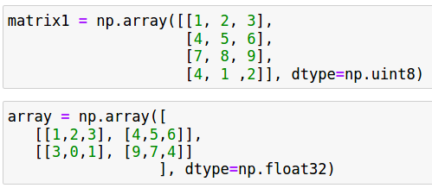
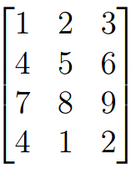
Numpy Array Creation 2

Slide 7
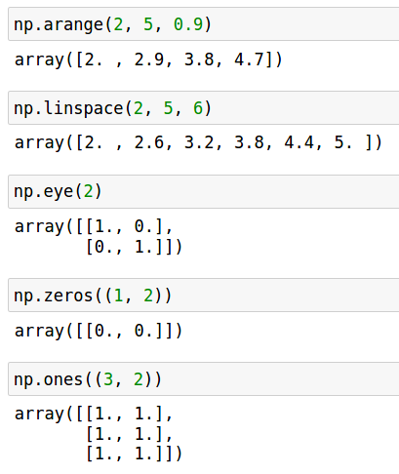
Numpy Array Creation 3
1D:
numpy.arange(start, end, step) (similar to the range function in Python)
numpy.linspace(start, stop, num, endpoint=True)
2D:
numpy.eye(number of rows)
General:
Numpy.zeros (shape, dtype)
numpy.ones(shape, dtype)

Slide 8
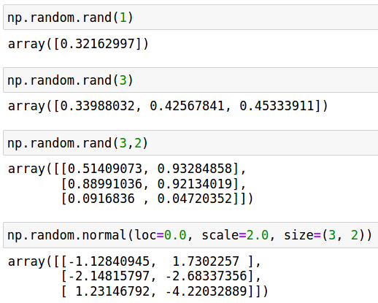
Numpy Array Creation 4 (Random Number Generation)
numpy.random.rand(shape)
numpy.random.randint(low, high, size)
numpy.random.normal(loc, scale, size)
numpy.random.beta(a, b, size)
numpy.random.standart_t(df, size)
numpy.random.uniform(low, high, size)
numpy.random.multinomial(n, p, size)
numpy.random.poisson(lam, size)

Slide 9
Basic Numpy Operations
Concatenation, Joining
Indexing and Slicing, Replication
Elementwise Multiplication, Addition, Subtraction, Division
Transpose
Dot Product
Matrix Multiplication
Reshaping and Retyping
Comparison and Search
Array statistics

Slide 10
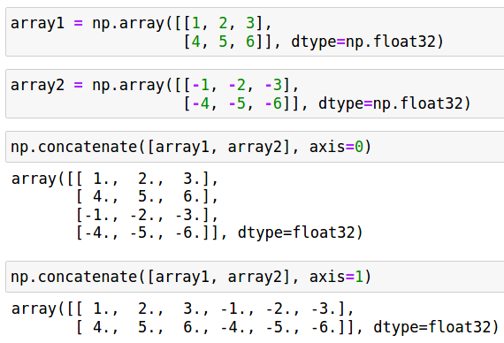
Numpy Array Concatenation
np.concatenate((a1, a2, a3 …), axis)
numpy.vstack(), numpy.hstack()

Slide 11
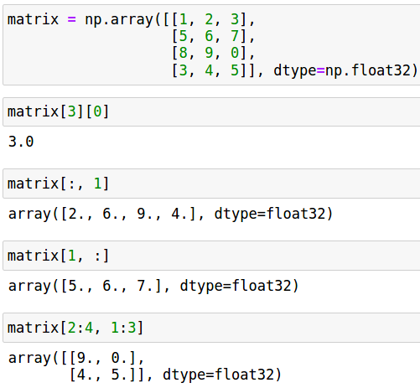
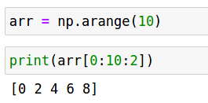
Numpy Indexing and Slicing, Replication
[i] -> Python like (minus values are valid)
[i][j][k] -> [i, j, k]
[i:n][j:m] -> [i:n, j:m]
[i:n:c] -> Python like
The returned array is a view:
A view is a copy of original array.
But they point to the same data.
Data is shared.
If one changes, the other changes.
To get a separate array, .copy() is used.
A view is created for performance reasons.

Slide 12
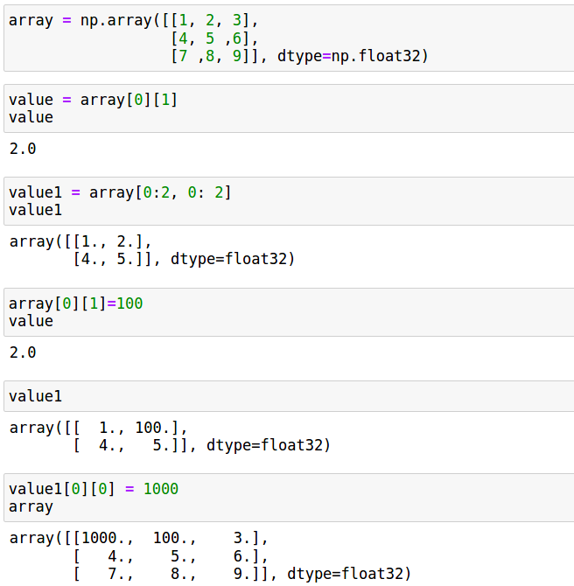
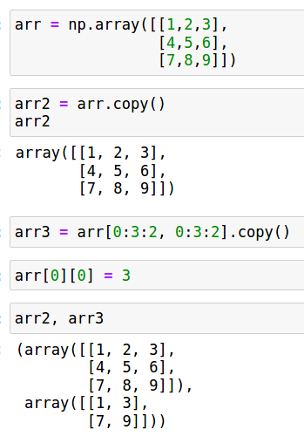
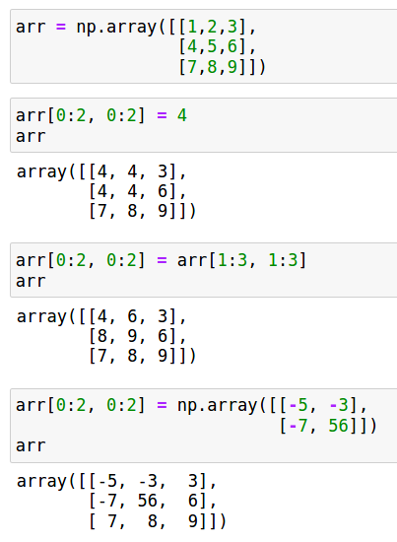
Numpy Indexing and Slicing 2

Slide 13
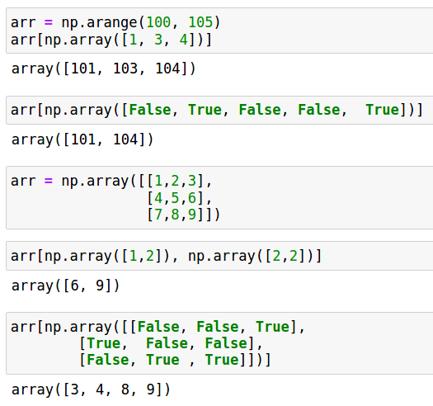
Numpy Indexing and Slicing 3 (Advanced Indexing)
While indexing arrays (of type bool or int) could be utilized as well.
Advanced indexing creates a copy not a view.

Slide 14
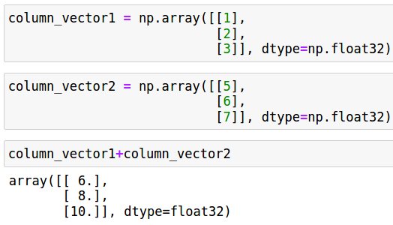
Numpy Elementwise Addition
numpy.add or ‘+’

Slide 15
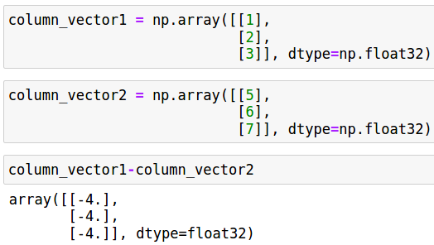
Numpy Elementwise Subtraction
np.subtract or ‘-’

Slide 16
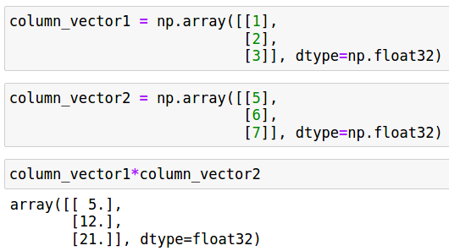
Numpy Elementwise Multiplication
numpy.multiply or ‘*’

Slide 17
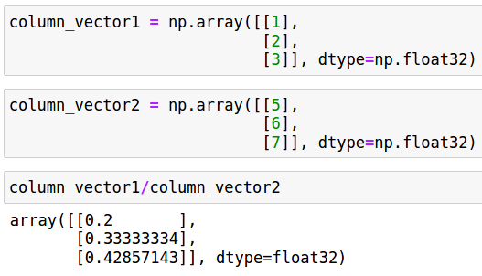
Numpy Elementwise Division
numpy.divide or ‘/’

Slide 18
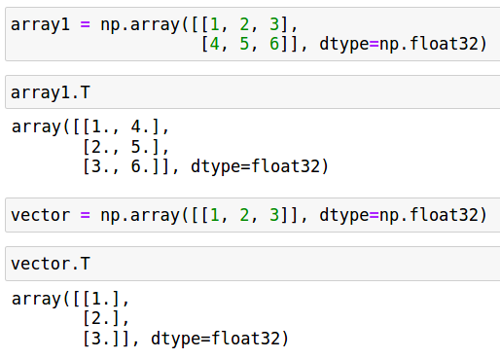
Numpy Transpose
numpy.transpose or ‘.T’ returns a view.

Slide 19
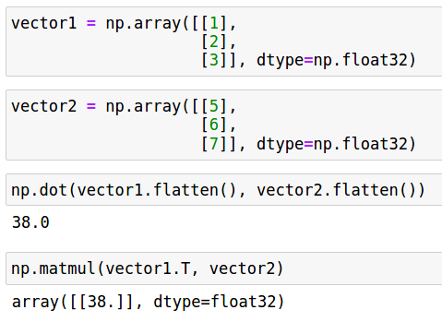
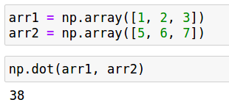
Numpy Dot Product
numpy.dot

Slide 20
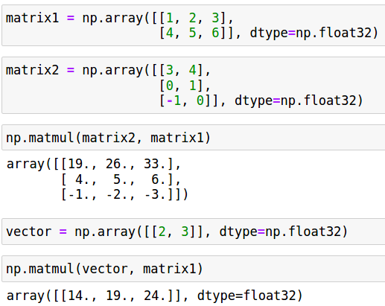
Numpy Matrix Multiplication
numpy.matmul or ‘@’

Slide 21
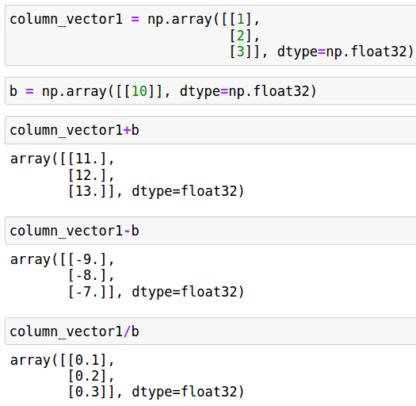
Numpy Broadcasting
“The term broadcasting describes how NumPy treats arrays with different shapes during arithmetic operations. Subject to certain constraints, the smaller array is “broadcast” across the larger array so that they have compatible shapes.” [*].
Similar behaviour exists in Pytorch.
[*] https://numpy.org/doc/stable/user/basics.broadcasting.html

Slide 22
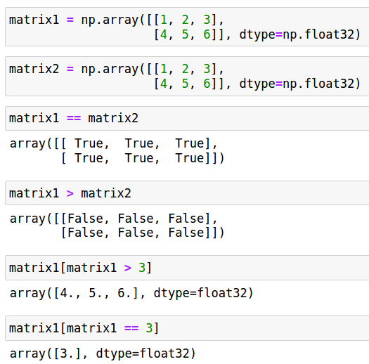
Numpy Comparison
numpy.greater
numpy.greater_equal
Numpy.array_equal
Numpy.less
numpy.less_equal
numpy.equal
Np.allclose: returns True/False
np.isclose: returns boolean array

Slide 23
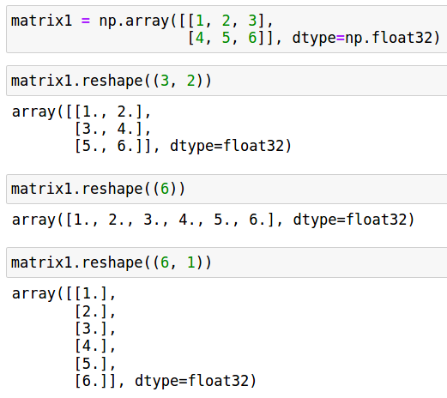
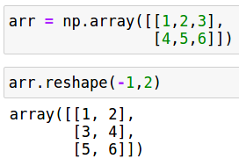
Numpy Reshaping and Retyping
numpy.reshape() -> a view or new array
-1 can be used for automatic reshaping
numpy.resize() -> new array
numpy.ravel() -> converts to 1D array
Flattens high dimensional arrays
For a view is desired : numpy.reshape(-1)
numpy.ndarray.astype () -> a new array
Returned array has the specified type.
numpy.ndarray.tolist() -> Python list

Slide 24
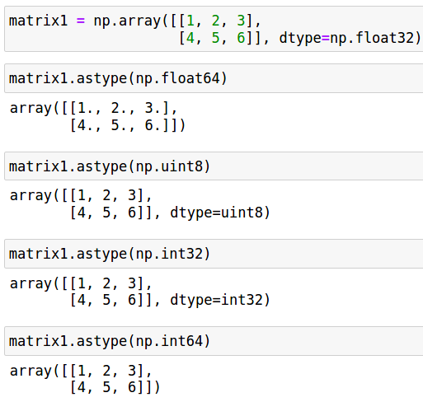
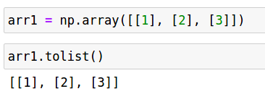
Numpy Reshaping and Retyping 2

Slide 25
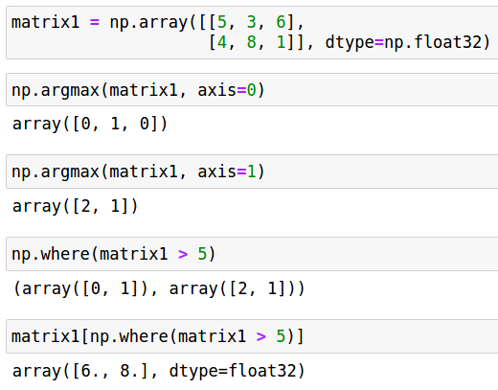
Numpy Search
numpy.argmax
numpy.argmin
numpy.where

Slide 26
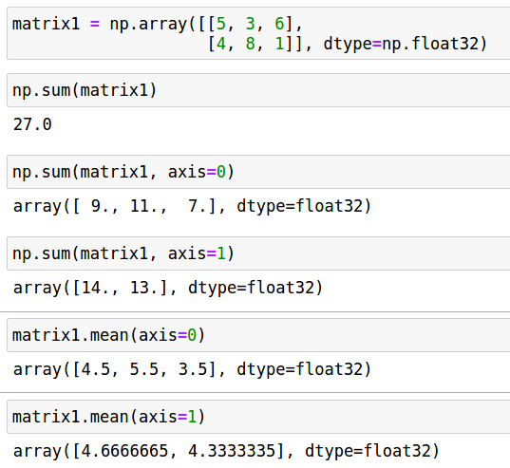
Numpy Array Statistics
numpy.sum
numpy.mean
numpy.max
numpy.min
numpy.std
numpy.var

Slide 27
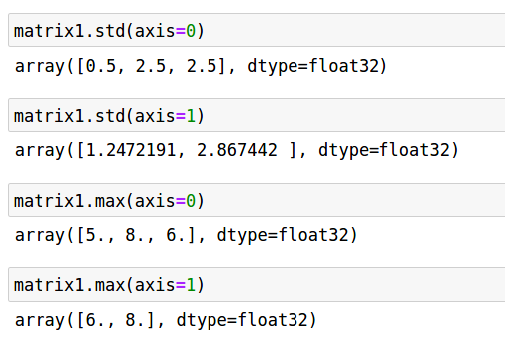
Numpy Array Statistics 2

Slide 28
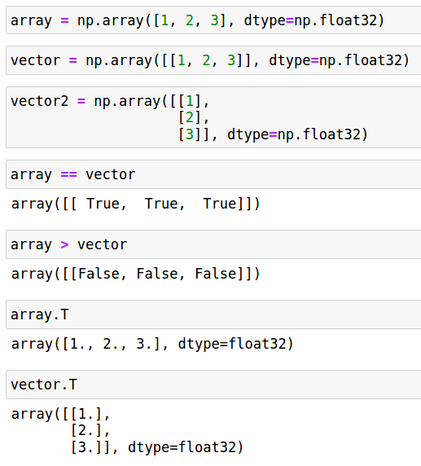
Numpy 1D Array (n) vs Vector (1xn or nx1 Array)

Slide 29

Numpy Random Number Generation
Distributions:
Numpy.random.(beta, binomial, uniform, normal, poisson, dirichlet, gamma, .etc)
.sample(): for sampling from distributions.
Number generation:
Numpy.random (rand, randint)
numpy.random.shuffle()
numpy.random.choice()
numpy.random.permutation()
numpy.random.seed(): for setting initial seed value

Slide 30
Numpy Functions
Linear Algebra:
numpy.linalg.(qr,svd,eig,det,solve, .etc)
Mathematical Functions:
numpy.(sin,cos,floor,ceil, exp, log, mod, clip, sqrt, square, power, sign, .etc)
Logic Functions:
numpy.(isinf, isnan, all, any, logical_and, logical_or, logical_xor_, logical_not)
Data input/output:
numpy.(save, load, savetxt, loadtxt

Slide 31
PyTorch
A Tensor library for deep learning
Runs on CPU and GPU/GPU Clusters
Automatic Differentiation System
Dynamic Computation Graph
Modular Neural Network Components
Custom
State-of-the-art
Customizable Data Loading Utilities
Logging (i.e SRM Plots) (With Tensorboard)

Slide 32
Pytorch Tensor
Fundamental array type for Pytorch for all operations
Can reside in CPU or GPU
Supports Numpy array operations
The ‘data’ member can be used to access elements of a tensor
The ‘requires_grad’ member specifies whether the gradient is to be calculated for the tensor
It stores gradient values and computation graph-related information.
‘grad_’ member stores the computed gradient weights
‘grad_fn’ member references the function that computes the gradients for the tensor
.dtype: to access the type of the tensor
.shape: to acces the shape tuple of the tensor

Slide 33
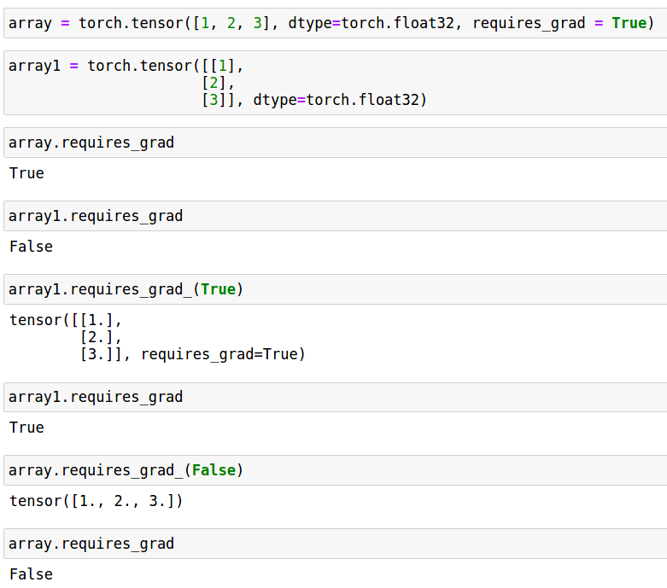
Pytorch Tensor Creation
torch.tensor(data, *, dtype, device, requires_grad)
torch.FloatTensor
torch.DoubleTesnor
torch.LongTensor
torch.IntTensor

Slide 34
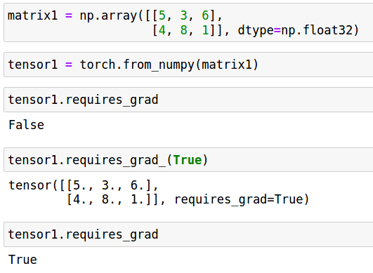
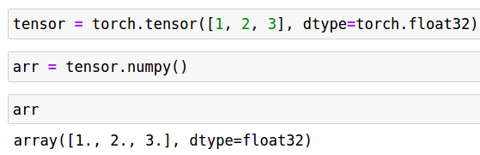
Pytorch Tensor Creation 2 (With numpy)
torch.from_numpy
torch.Tensor.numpy()
Converts torch tensor to numpy array

Slide 35
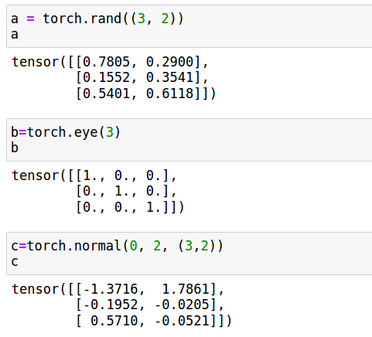
Pytorch Tensor Creation 3
torch.arange
torch.linspace
torch.eye
torch.normal
torch.rand
torch.zeros
torch.ones

Slide 36
Basic Pytorch Tensor Operations
Concatenation
Indexing and Slicing, Replication
Elementwise Multiplication, Addition, Subtraction Division
Transpose
Dot Product
Matrix Multiplication
Reshaping and Retyping
Comparison and Search
Array statistics
** ‘axis = x‘ should be changed to ‘dim = x‘.
** Broadcasting is valid for Pytorch Tensors too.

Slide 37
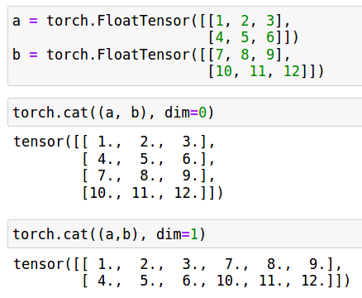
Pytorch Tensor Concatenation
torch.cat(tensors, dim)

Slide 38
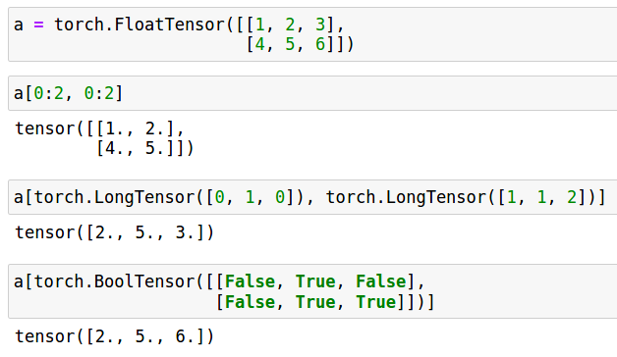
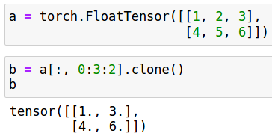
Pytorch Tensor Indexing and Slicing
Pytorch follows the slicing/indexing convention of Numpy.
Advanced indexing is supported too.
Returned tensors by indexing and slicing operation are views.
They share the same data. If one changes the other changes as well.
To copy the original data and create a separate tensor: .clone() is used.

Slide 39
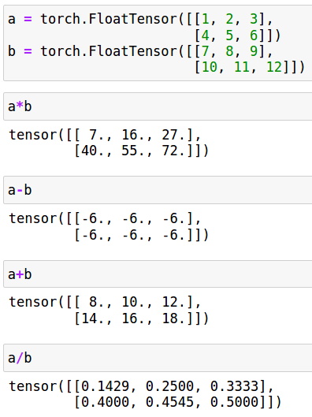
Elementwise Multiplication/Addition/Subtraction/Dividion
Torch.add() or ‘+’
Torch.subtract() or ‘-’
Torch.multiply() or ‘*’
torch.divide() or ‘/’

Slide 40
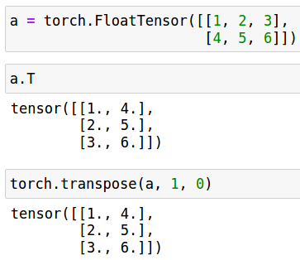
Pytorch Tensor Transpose
Torch.transpose or torch.Tensor.T : both return a view from the original tensor.

Slide 41
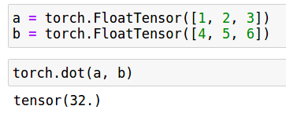
Pytorch Dot Product
torch.dot

Slide 42
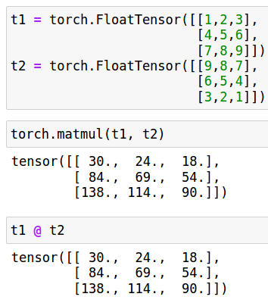
Pytorch Matrix Multiplication
torch.matmul or ‘@’

Slide 43
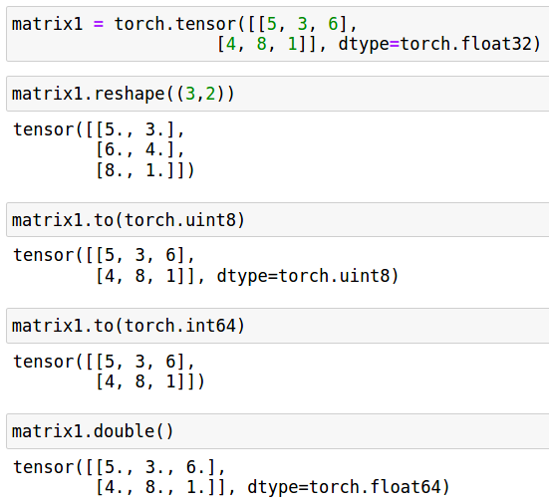
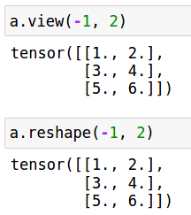
Pytorch Tensor Reshaping and Retyping
torch.reshape: view or copy()
-1 can be used for automatic shaping.
torch.Tensor.view()
Returns a view with a new shape
torch.Tensor.to(): a new tensor
Creates a new array with a new type
Creates a new array with a new device
torch.Tensor.float()/int()/bool()/.etc

Slide 44
Pytorch Tensor Reshaping and Retyping

Slide 45
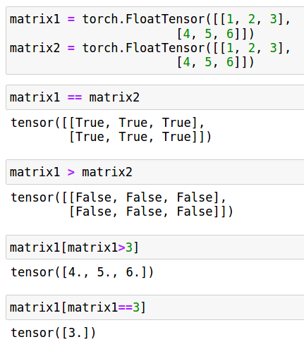
Pytorch Tensor Comparison
torch.greater
torch.greater_equal
torch.less
torch.less_equal
torch.equal
torch.allclose: returns True/False
torch.isclose: returns boolean array

Slide 46
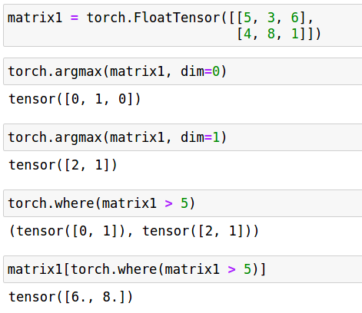
Pytorch Tensor Search
torch.argmax
torch.argmin
torch.where

Slide 47
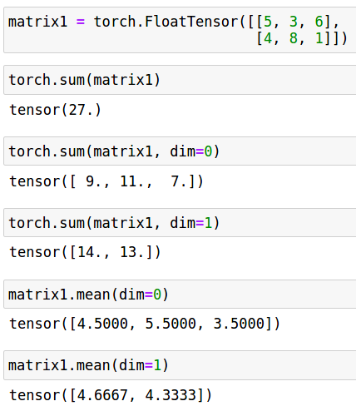
Pytorch Tensor Statistics
torch.sum
torch.mean
torch.max
torch.min
torch.std
torch.var

Slide 48
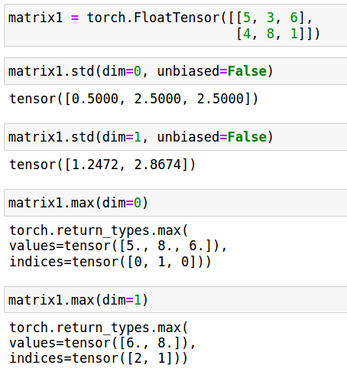
Pytorch Tensor Statistics 2

Slide 49

Pytorch Random Number Generation
Distributions:
torch.distributions.(bernoulli, beta, binomial, categorical, cauchy, dirichlet, gamma, .etc)
.sample(): for sampling from distributions.
Number generation:
torch.(rand, randint)
numpy.rand.perm()
torch.manual_seed(): for setting initial seed value for all devices (both CPU and GPU.

Slide 50
Pytorch Functions
Linear Algebra:
torch.linalg.(qr,svd,eig,det,solve, .etc)
Mathematical Functions:
torch.(sin,cos,floor,ceil, exp, log, remainder, clip/clamp, sqrt, square, pow, sign, .etc)
Logic Functions:
torch.(isinf, isnan, all, any, logical_and, logical_or, logical_xor_, logical_not)
Data input/output:
torch.(save, load)

Slide 51
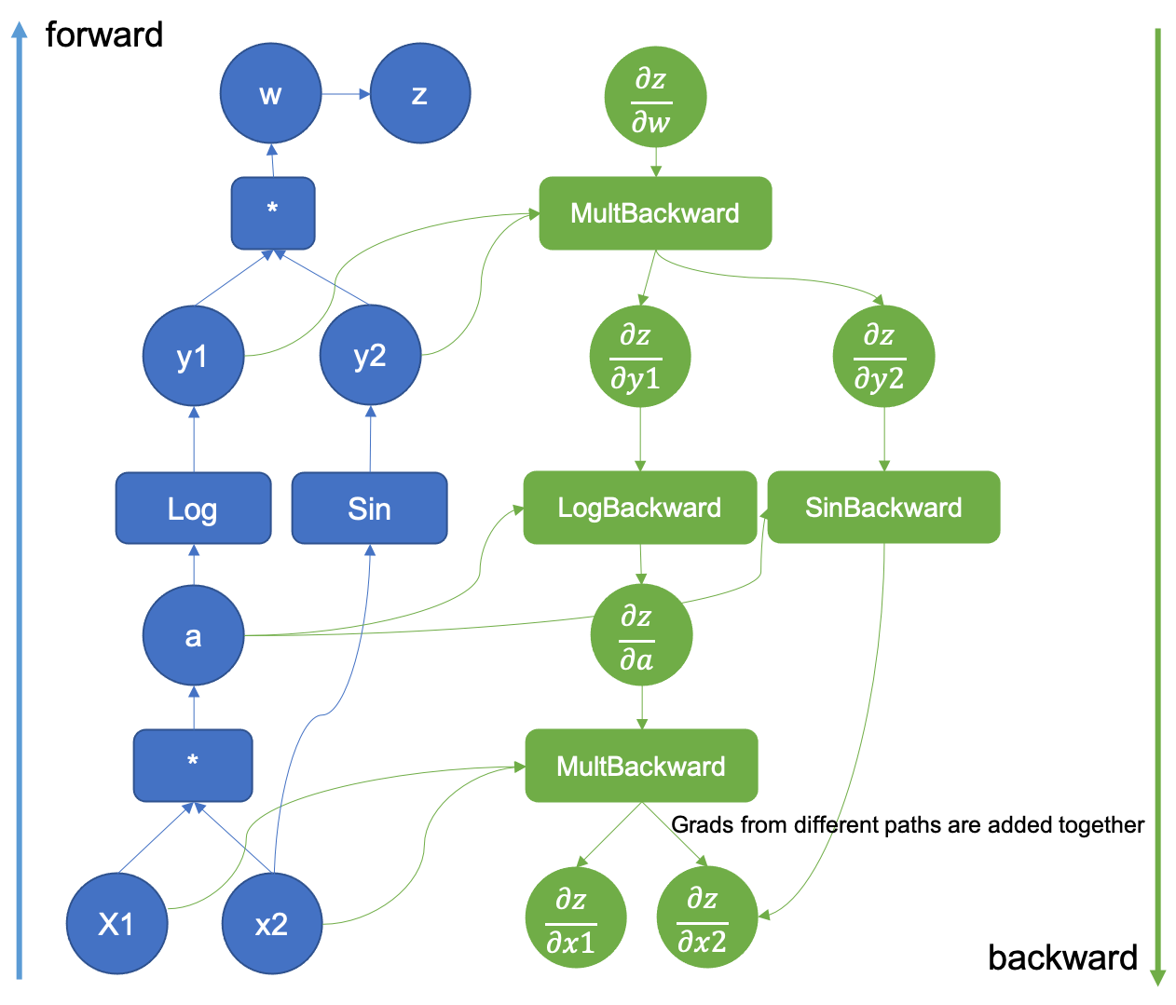
Computation Graph
Image Source: https://pytorch.org/blog/computational-graphs-constructed-in-pytorch/

Slide 52
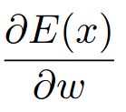
Pytorch Auto-Gradient Engine/System
As the computations are executed (forward pass), it constructs a computation graph.
For every tensor whose required_grad = True, it keeps track of it in the computation graph.
As each forward pass, it reconstructs the computation graph, hence it is a dynamic computation graph.
When ‘.backward()’ function is called, backpropagation is initiated and each tensor’s grad_fn is called and the calculated weights are stored in ‘grad_’ member.
Can calculate second-order derivatives (i.e. Hessian matrix).

Slide 53



Pytorch Loss Functions
Loss functions measure the discrepancy between predictions and ground truths.
Depending on the task type, the most suitable loss function changes.
Generally nn.CrossEntropyLoss for classification tasks, nn.MSELoss for regression tasks.

Slide 54

Pytorch Optimizers
Auto-grad system calculates the gradient values for each tensor (whose require_grad = True)
Optimizers modify the tensors with their gradient values.
Adaptive learning rate schemes are supported
ADAM, RMSProp, SGD, AdaDelta, etc.
Custom optimization schemes

Slide 55
Pytorch Optimizers
Creation:
optimizer = optim.OPTIMIZER([trainable parameters list], optimizer parameters)
optimizer = optim.SGD([*parameter list*], lr=0.01, momentum=0.9)
‘zero_grad()’ function zeros all the gradient values of tensors (passed in the trainable parameter list).
‘step()’ function applies the actual change on the weights of tensors (passed in the trainable parameter list).

Slide 56
How to Define Neural Network Architecture
Manually with explicit tensor definitions
The hardest way
Error-prone
Debugging is hard
nn.Module
Reusability and Modularity (i.e. ‘Plug-and-play’ components)
Provides state-of-the-art neural network components (i.e CNN, LSTM, GRU, etc. layers)
nn.Sequential
The simplest way
Keras-like Model Definition

Slide 57

Neural Network Definition with nn.Module
All network parameters are initialized with random numbers automatically.
All network parameters’ requires_grad members are set to True automatically.

Slide 58

Neural Network Definition with nn.Sequential
All network parameters are initialized with random numbers automatically.
All network parameters’ requires_grad members are set to True automatically.

Slide 59
nn.Sequential, nn.Module, nn.ModuleList
nn.Sequential, nn.Module, nn.ModuleList
Facilitates modularity.
Neural architectures can be defined in a bottom up fashion
Each individual component can be a particular layer
They can be combined to obtain a larger network
A defined module can be used in different architectures easily
.parameters() function return all defined parameters for a module.
.state_dict() function returns a dictionary that map each layer to its parameters
Generally it is used to save a current state of a neural network to a file or to load from a file.
Pytorch optimizers have state as well. (They can be saved and loaded)

Slide 60

Pytorch nn.Linear
nn.Linear(in_features, output_features, bias=True, device)
Represents weights and biases between two layers
Defines a weight matrix (of size output_featuresxin_features) and bias matrix (of size 1xoutput_features)
Applies the operation:
Weights and biases can be accessed:
.weight
.bias
If the input tensor has a size Nxin_features, it outputs a tensor of size Nxoutput_features

Slide 61


Optimizer and Loss Function Definitions
These loss functions calculate average cross entropy and MSE, respectively.

Slide 62
Other Pytorch Notes
Tensorboard
GPU Cluster Support
Data loader
Packages: torchvision, torchaudio, torchtext

Slide 63
Typical Steps to Train a Neural Network
Data Loading
Data Preprocessing
Neural Network Model Definition
Optimizer & Loss Function Definition
Training Loop
Evaluation on Validation Dataset
Evaluation on Test Dataset

Slide 64

Training Loop (With Batch Gradient)

Slide 65

Training Loop (With Stochastic Gradient)

Slide 66

Training Loop (Minibatch Batch Gradient)

Slide 67
How to Disable Gradient Calculations?
Auto-grad system always keeps track of gradient operations for each operation (for each tensor whose requires_grad = True)
Gradient operations are required only for training.
To disable gradient operations for a computation:
Setting required_grad manually for each trainable tensor via requires_grad_(False)
Hard to keep track of which tensors are set or disabled
Error-prone
with torch.no_autograd():
with block defines a scope/block where gradient operations are disabled
For modules model.eval(), model.train()

Slide 68

Evaluation on Validation Dataset

Slide 69

Evaluation on Test Dataset

Slide 70

Pytorch Parameter Tracking

Slide 71

Pytorch Saving and Loading Network Model

Slide 72
Pytorch Example
Adaline Example

Slide 73
Pytorch Example
Feed Forward Network Example

